Slide 1



Slide 2



01CE0410 – Computer Network
Unit - 4
Network Layer

Slide 3
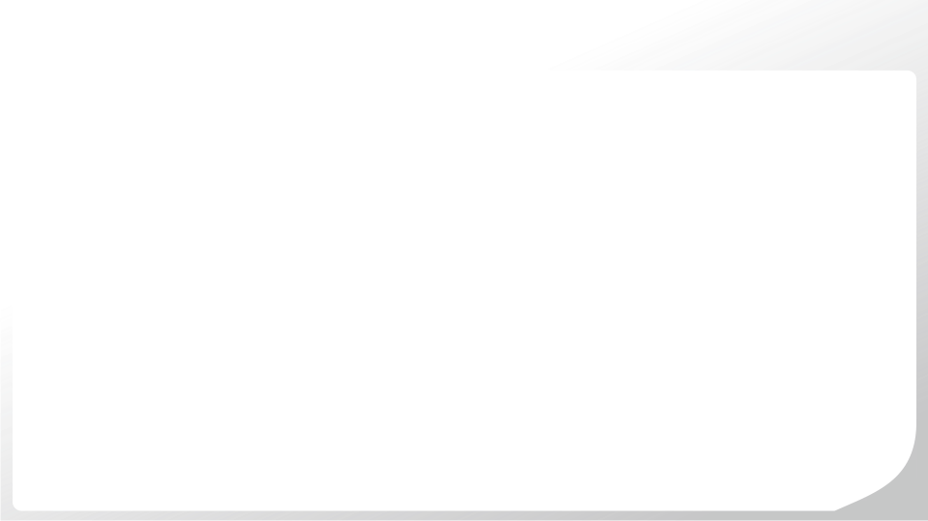
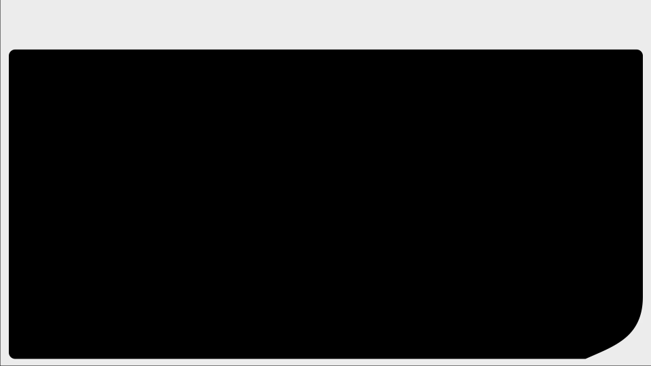
Outline
Network Layer Functionalities
Network layer design issues
IP Address and Subnetting
IPv4 Header
Unicast Routing & Multicast Routing
Classification of Unicast Routing
Intradomain Routing
Distance Vector Routing (RIP)
Link State Routing (OSPF)
Interdomain Routing
Path Vector Routing (BGP)
EIGRP(Enhanced Interior Gateway Routing Protocol)

Slide 4

Network Layer Functionalities

Slide 5
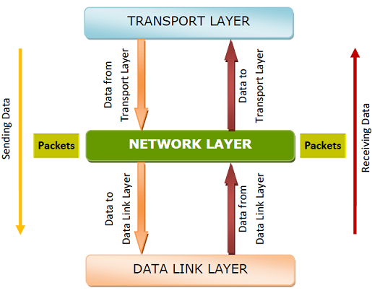
Network Layer Functionalities
When data is to be sent, the network layer accepts data from the transport layer above, divides and encapsulates it into packets and sends it to the data link layer. The reverse procedure is done during receiving data.
The network layer is responsible for routing packets from the source host to the destination host. The routes can be based upon static tables that are rarely changed; or they can be automatically updated depending upon network conditions.
Many networks are partitioned into sub-networks or subnets. The network layer controls the operations of the subnets. Network devices called routers operate in this layer to forward packets between the subnets or the different networks.

Slide 6
Network Layer Functionalities
The lower layers assign the physical address locally. When the data packets are routed to remote locations, a logical addressing scheme is required to differentiate the source system and the destination system. This is provided by the network layer.
This layer also provides mechanisms for congestion control, in situations when too many packets overload the subnets.
The network layer tackles issues like transmission delays, transmission time, avoidance of jitters etc.
Notes:
Jitter is the variation in time delay between when a signal is transmitted and when it's received over a network connection, measuring the variability in ping. This is often caused by network congestion, poor hardware performance and not implementing packet prioritization. Jitter is when there is a time delay over your network connection.

Slide 7
Network Layer Design Issues

Slide 8
Network Layer Design Issues
The design issues can be elaborated under four heads −
Store − and − Forward Packet Switching
Services to Transport Layer
Providing Connection Oriented Service
Providing Connectionless Service

Slide 9
Network Layer Design Issues
Store and Forward packet switching
The host sends the packet to the nearest router. This packet is stored there until it has fully arrived. Once the link is fully processed by verifying the checksum then it is forwarded to the next router till it reaches the destination. This mechanism is called “Store and Forward packet switching.”
Services to Transport Layer
The network layer provides service its immediate upper layer, namely transport layer, through the network − transport layer interface. The two types of services provided are −
Connection − Oriented Service − In this service, a path is setup between the source and the destination, and all the data packets belonging to a message are routed along this path.
Connectionless Service − In this service, each packet of the message is considered as an independent entity and is individually routed from the source to the destination.

Slide 10
Network Layer Design Issues
Providing Connection Oriented Service
In connection − oriented services, a path or route called a virtual circuit is setup between the source and the destination nodes before the transmission starts. All the packets in the message are sent along this route. Each packet contains an identifier that denotes the virtual circuit to which it belongs to. When all the packets are transmitted, the virtual circuit is terminated and the connection is released.
Providing Connection less Service
In connectionless service, since each packet is transmitted independently, each packet contains its routing information and is termed as datagram. The network using datagrams for transmission is called datagram networks or datagram subnets. No prior setup of routes are needed before transmitting a message. Each datagram belong to the message follows its own individual route from the source to the destination.

Slide 11
IP Address & Subnetting

Slide 12
IP Addresses
IP address stands for Internet Protocol address.
Having an IP address allows a device to communicate with other devices over an IP-based network like the internet.
An IP address provides an identity to a networked device.
The address structure was originally defined to have a two level hierarchy : Network ID and host ID.
The network ID identifies the network in which the host is connected. The host ID identifies the network connection to the host.

Slide 13
IP Addresses
There are 2 types of IP addresses: IPv4 and IPv6.
IPv4 uses 32-bits addresses, which means that the address space is 2³² = 4, 29, 49,67,296.
IPv6 uses 128-bits addresses, which means that the address space is 2¹²⁸
2¹²⁸ = 340,282,366,920,938,463,463,374,607,431,768,211,456

Slide 14
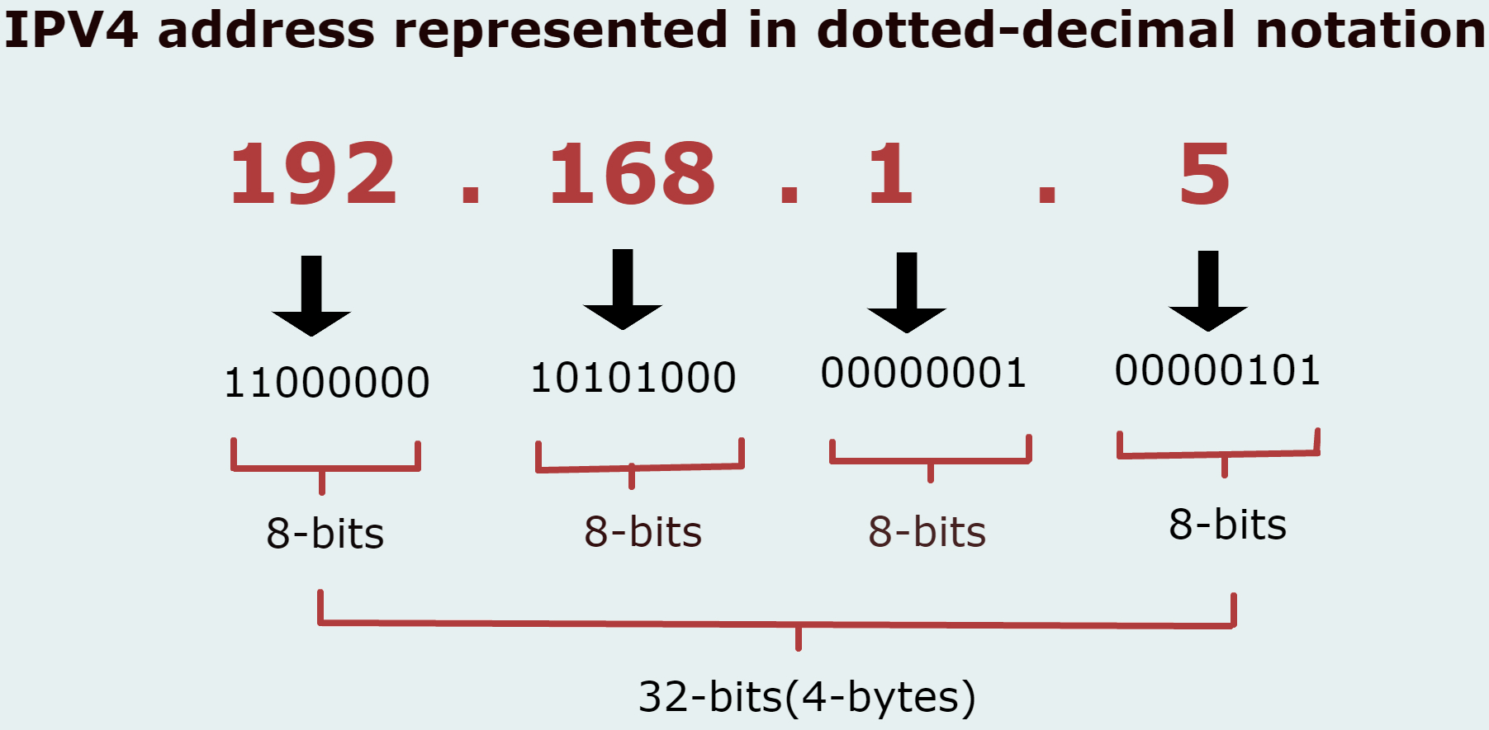
IPv4 Addresses
IP addresses are usually written in dotted decimal notation.
The address broken into four bytes with each byte represented by a decimal number and separated by a dot.
For example, an IP address of – 192.168.1.5

Slide 15
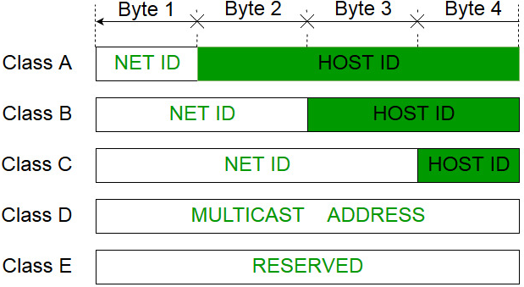
IPv4 Addresses
Format of IPv4 Address:
Notes:
Class A Net ID- 8 bits means 2 to power 8=256 networks
Host ID – 24 bits means 2 to the power of 24 = 1,67,77,216 hosts
Class B Net ID-16 bits means 2 to power of 16= 65,536 networks and Same number of hosts

Slide 16

IPv4 Addresses
Class A – 0 to 127
Class B – 128 to 191
Class C – 192 to 223
Class D – 224 to 239 - Multicasting
Class E – 240 to 255 – Reserved for future use

Slide 17
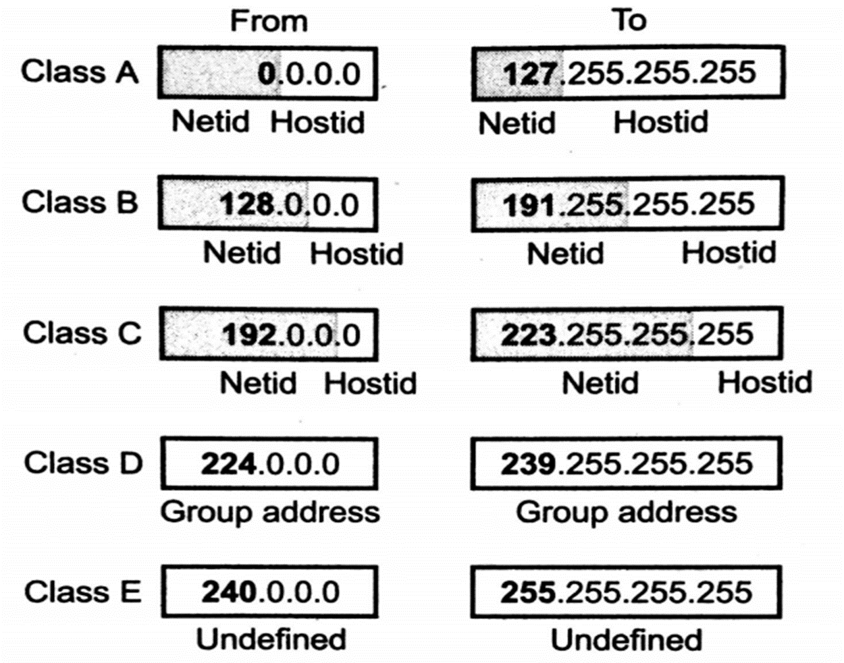
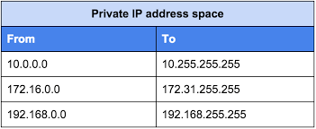
IPv4 Addresses
Class A → 0.0.0.0 to 127.255.255.255
Class B → 128.0.0.0 to 191.255.255.255
Class C → 192.0.0.0 to 223.255.255.255
Class D → 224.0.0.0 to 239.255.255.255
Class E → 240.0.0.0 to 255.255.255.255
Range of Private IP Addresses

Slide 18
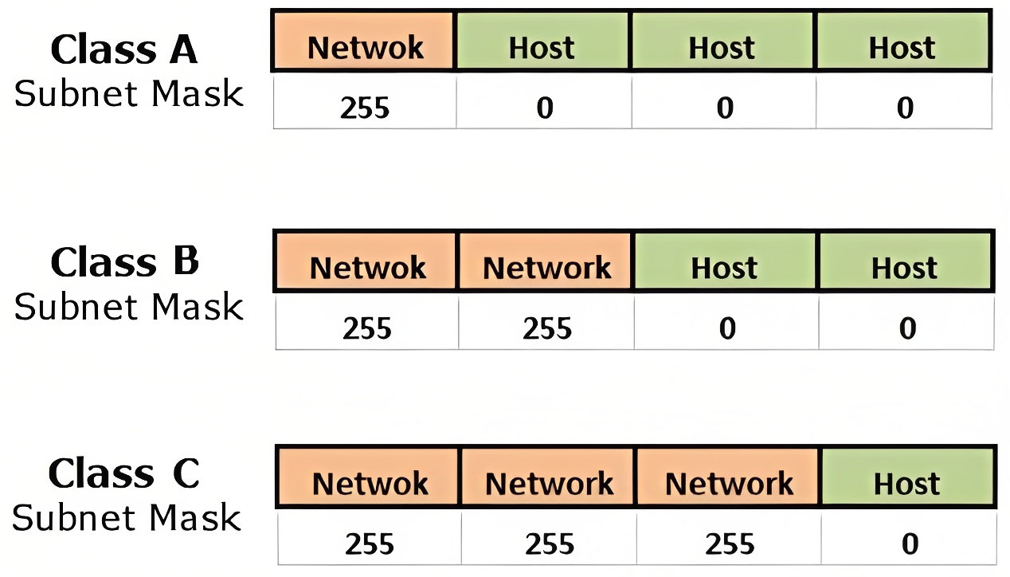
Subnetting
When a bigger network is divided into smaller networks, then that is known as Subnetting. So, maintenance is easier for smaller networks.
For example, if we consider a class A address, the possible number of hosts is 2²⁴ for each network, it is obvious that it is difficult to maintain such a huge number of hosts, but it would be quite easier to maintain if we divide the network into small parts.

Slide 19
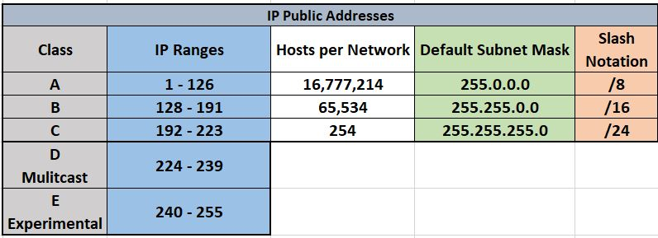
Subnetting
Default Subnet Mask

Slide 20
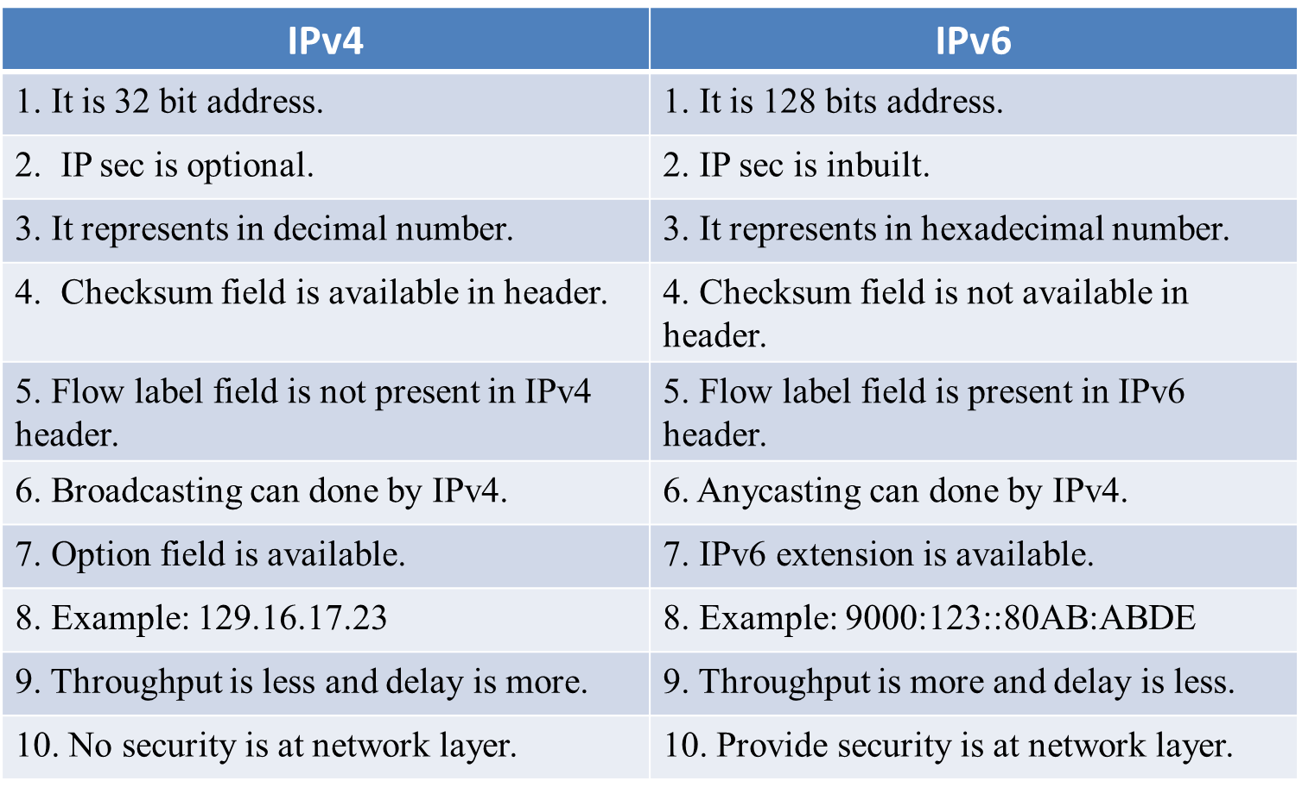
IPv4 vs IPv6
6

Slide 21
IPv4 Header

Slide 22
IPv4 Introduction
IPv4, where IP stands for Internet Protocol, and v4 stands for Version Four, is used to route Internet traffic and other packet-switched layer networks, such as Ethernet.
It is a 32-bit address that is organized into four octets of 8 bits (4x8), which is often expressed in dotted decimal numbers and looks like this: 172.140.153.12.
IPv4 (Internet Protocol Version 4) is the first major version (Fourth version) of the Internet Protocol and is a widely used protocol for transmitting data over various networks.
It is a connectionless protocol that is used in packet-switched networks.
By providing an identity for each network device, it establishes a logical connection between them.
It is a connectionless, unreliable datagram protocol that uses a best-effort delivery strategy. The term best effort refers to the fact that IPv4 provides no error or flow control.

Slide 23
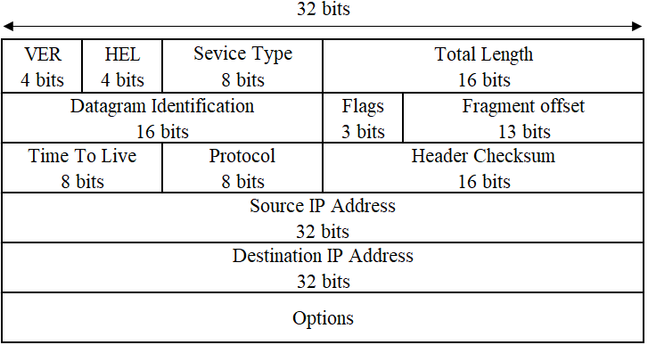
IPv4 Header

Slide 24
IPv4 Header
VER: This field contains the version of IP.
HLEN: It is the length of the IP header. It is 4 bits which specifies the number of 32 bits words.
Service Type: This service type is an indication of the quality of service requested for this IP datagram. Ex., Less Delay, High Throughput, Reliability of packet.
Total Length: It specifies the total length of the datagram.
Datagram = Header + Data.
Header = 20 Bytes to 60 Bytes
Data = 20 Bytes to 65535 Bytes
Datagram Identification: It is a unique number assigned by the sender used with fragmentation.
Flags: it contains 3 bits:
The 1st bit is reserved and must be zero.
The 2nd bit is DF (Do not fragment), 0 means allow fragmentation.
The 3rd bit is MF (More fragment), 0 means least fragment.
Fragment Offset: It is used to reassemble the full datagram.

Slide 25
IPv4 Header
TTL: TTL stands for Time to live. It is specifying the time; datagram is allowed to travel.
Protocol Number: It indicates the higher layer protocol to which IP should deliver the data in this datagram. E.g., ICMP = 1, TCP = 6, UDP = 17.
Header Checksum: It is a checksum for the information contained in the header. If the header checksum does not match the contents, the datagram is discarded.
Source IP address: It specify the logical address of sender.
Destination IP address: It specify the logical address of destination.
IP Options: It is a variable length field used for control or debugging and measurement. E.g., Timestamp, security and record route etc…

Slide 26
Unicast Routing & Multicast Routing

Slide 27
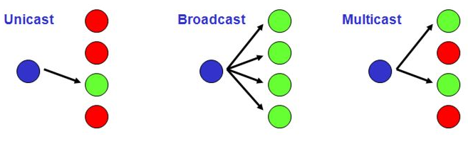
Unicast – Multicast – Broadcast Routing
In unicast, the router forwards the received packet through only one of its interface.
In multicasting, the router forwards the received packet through several interfaces.
In broadcasting, the router may forward the received packet to all the interfaces.

Slide 28
Classification of Unicast Routing Protocol

Slide 29
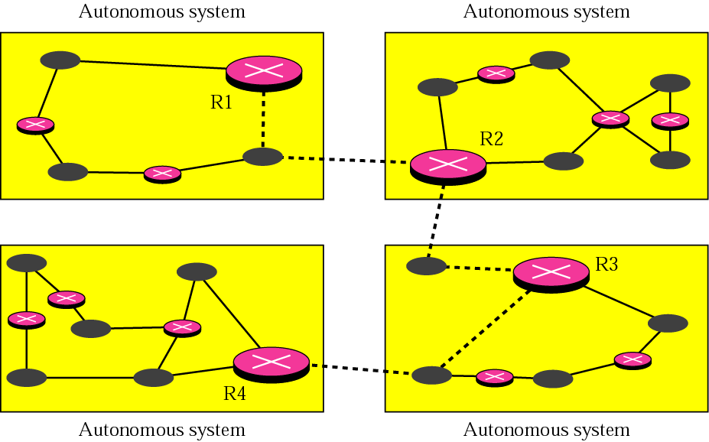
Classification of Unicast Routing Protocol
An internet is divided into autonomous systems. An autonomous system is a group of networks and routers under the authority of a single administration.
Only one inter-domain routing protocol handles routing between autonomous systems.

Slide 30
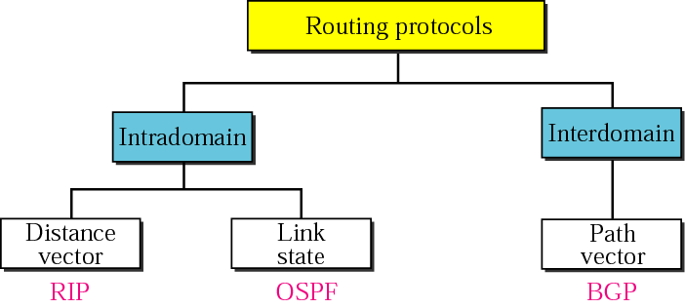
Classification of Unicast Routing Protocol
Routing inside an autonomous system is referred to as intra-domain routing.
Routing between autonomous system is referred to as inter-domain routing.
RIP: Routing Information Protocol
OSPF: Open Shortest Path First
BGP: Border Gateway Protocol

Slide 31
Intradomain Routing Protocol
Distance Vector Routing (RIP)
Link State Routing (OSPF)

Slide 32
Distance Vector Routing (RIP)

Slide 33
Distance Vector Routing
A router using distance vector routing protocols knows two things:
Distance to final destination.
Vector, or direction, traffic should be directed.
Characteristics:
Periodic updates
Alive neighbors
Broadcast updates
Entire routing table is included with routing update
Routing updates:
Routing table updates occur periodically or when the topology changes.
Directly connected networks are initially placed in routing table
Distance vector algorithms call for each router to send its entire routing table to each of its adjacent neighbors.
Notes:
Broadcast Updates
When a router first becomes active on a network, how does it find other routers and how does it announce its own presence? Several methods are available. The simplest is to send the updates to the broadcast address (in the case of IP, 255.255.255.255). Neighboring routers speaking the same routing protocol will hear the broadcasts and take appropriate action. Hosts and other devices uninterested in the routing updates will simply drop the packets.

Slide 34
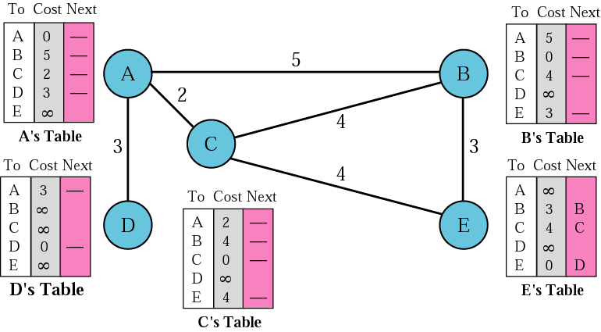
Distance Vector Routing
Initialization

Slide 35
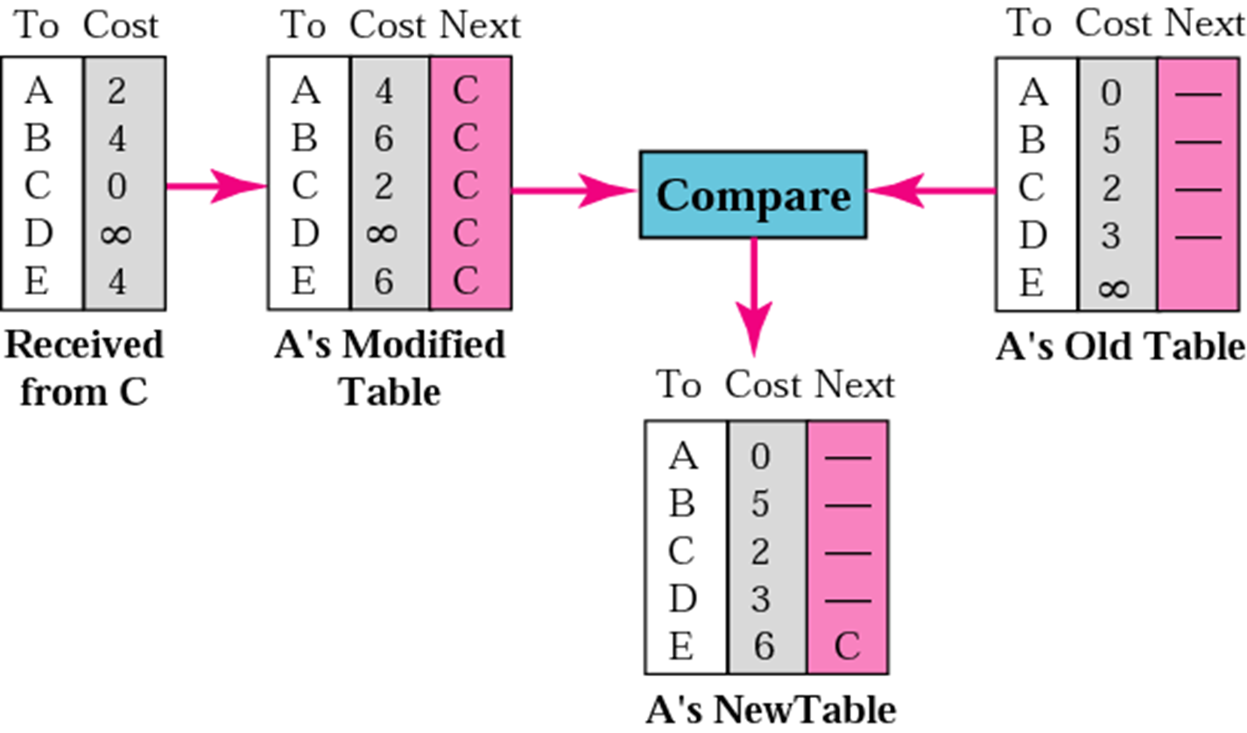
Distance Vector Routing
Update table of Node A

Slide 36
Distance Vector Routing
Advantages
Simple Implementation and maintenance.
Low Resource requirements.
Less memory.
No need of Powerful CPU.
Disadvantages
Slow Convergence or count to infinity in which inconsistencies arise because routing update messages propagate slowly across the network. .
Limited Scalability.
Routing Loops.

Slide 37
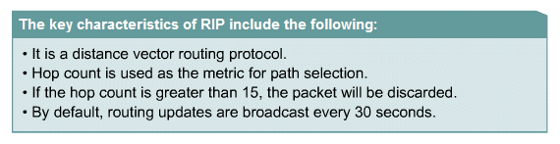
Routing Information Protocol (RIP)
The Routing Information Protocol (RIP) is an intra-domain routing protocol used inside an autonomous system.
It is a very simple protocol based on distance vector routing.
RIP uses the services of UDP on well-known port 520.
Characteristics:

Slide 38
Routing Information Protocol (RIP)
RIP uses 4 types of timers:
Update timer
Invalid timer
Hold-down timer
Flush timer
Update timer
The default RIP updates interval ：30 sec
To change the update internal: (Config-router)#update-timer seconds
Passive-interface command: Disable the sending of routing updates on specified interfaces
Invalid timer
If an update has not been received for a long time.
After 180 seconds, the route is marked as invalid by setting the metric to 16.
Notes:
In RIP, a hop count of 16 means infinity, or that the destination cannot be reached.

Slide 39
Routing Information Protocol (RIP)
Hold-down timer
Once a route is marked as unreachable, it must stay in hold-down long enough for all routers in the topology to learn about the unreachable network.
By default, the hold-down timer is set for 180 seconds.
Flush timer
By default, the flush timer is set for 240 seconds.
When the flush timer expires, the route is removed from the routing table
A problem with distance vector routing is instability, which means that a network using this protocol can become unstable

Slide 40
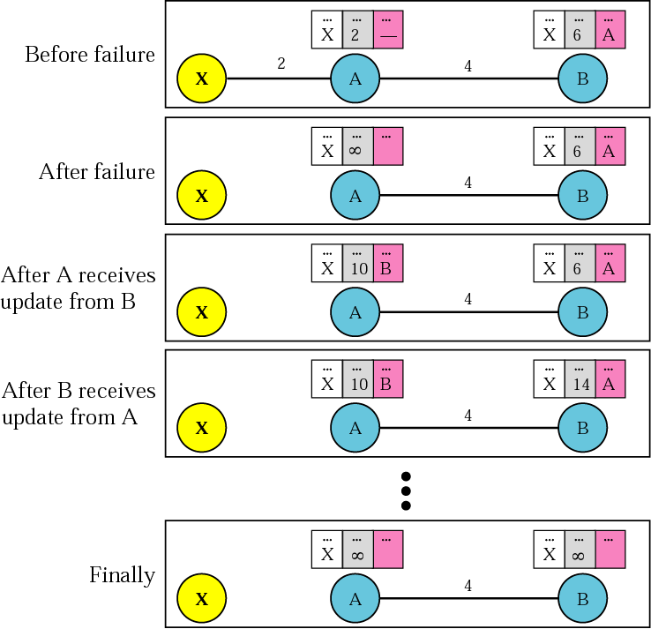
Routing Information Protocol (RIP)
Two node Instability

Slide 41
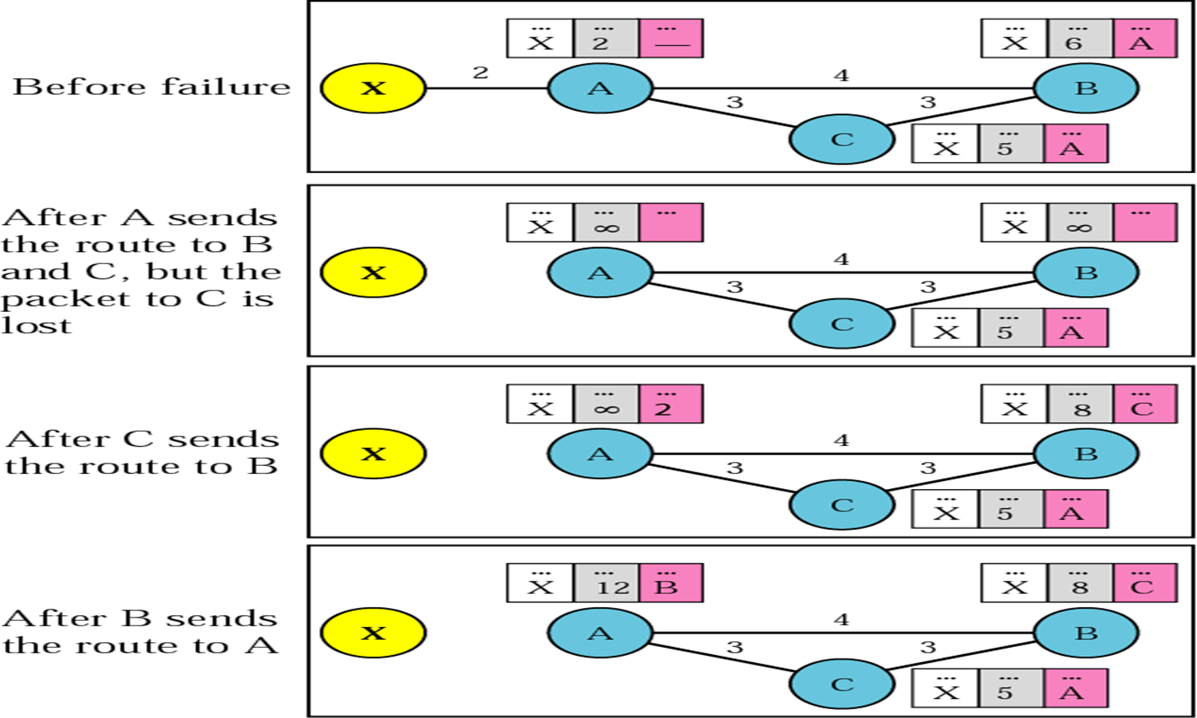
Routing Information Protocol (RIP)
Three node Instability

Slide 42
Link State Routing (OSPF)

Slide 43
Link State Routing
Developed to overcome the disadvantages of the distance vector protocols.
Link – This is an interface on a router.
Link State – This is the information about the state of the links.
Characteristics:
Updates are incremental & entire routing table is not sent as update.
Updates are triggered not periodic.
Updates are sent to entire network.
Routers have visibility of entire network of that area only.
No routing loops.
Convergence is fast because of triggered updates.

Slide 44
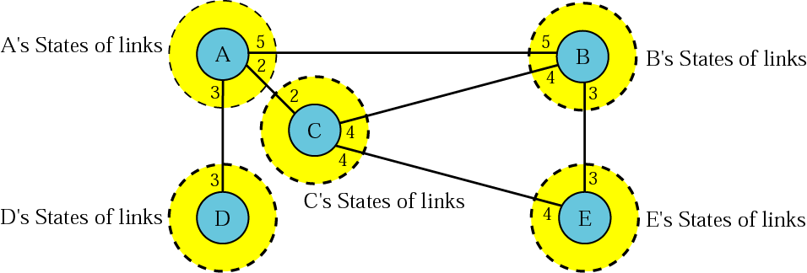
Link State Routing
Developed to overcome the disadvantages of the distance vector protocols.
Each router learns about its own directly connected networks.
Link state routers exchange hello packet to “meet” other directly connected link state routers.

Slide 45
Link State Routing
Each router builds its own Link State Packet (LSP) which includes information about neighbors such as neighbor ID, link type & bandwidth.
After the LSP is created the router floods it to all neighbors who then store the information and then forward it until all routers have the same information.
Once all the routers have received all the LSPs, the routers then construct a topological map of the network which is used to determine the best routes to a destination.
Each router maintains a database of all received LSAs (Link State Advertisements).
Each router uses its link state database to run a shortest path algorithm (Dijikstra’s algorithm) to produce the shortest path to each network
Metric
Administrator can assign the cost to each route.
Based on type of service (minimum delay, maximum throughput, and so on)

Slide 46
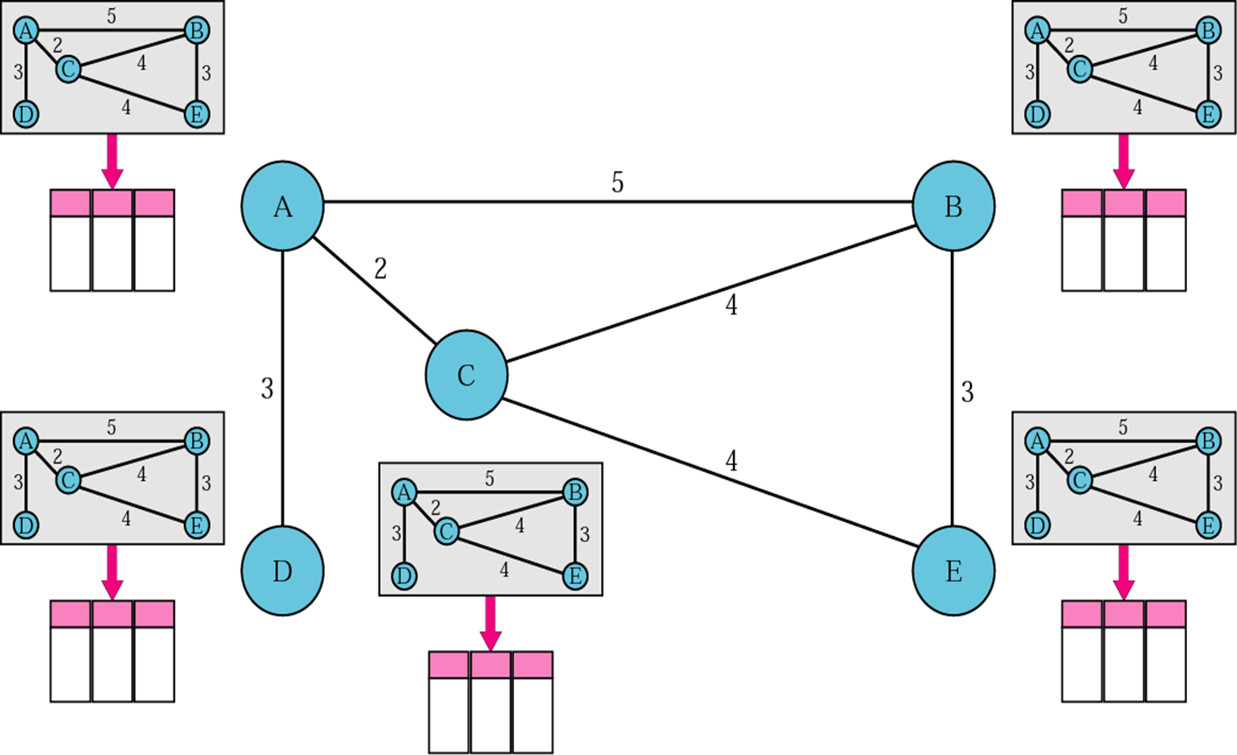
Link State Routing
Concept of Link State

Slide 47
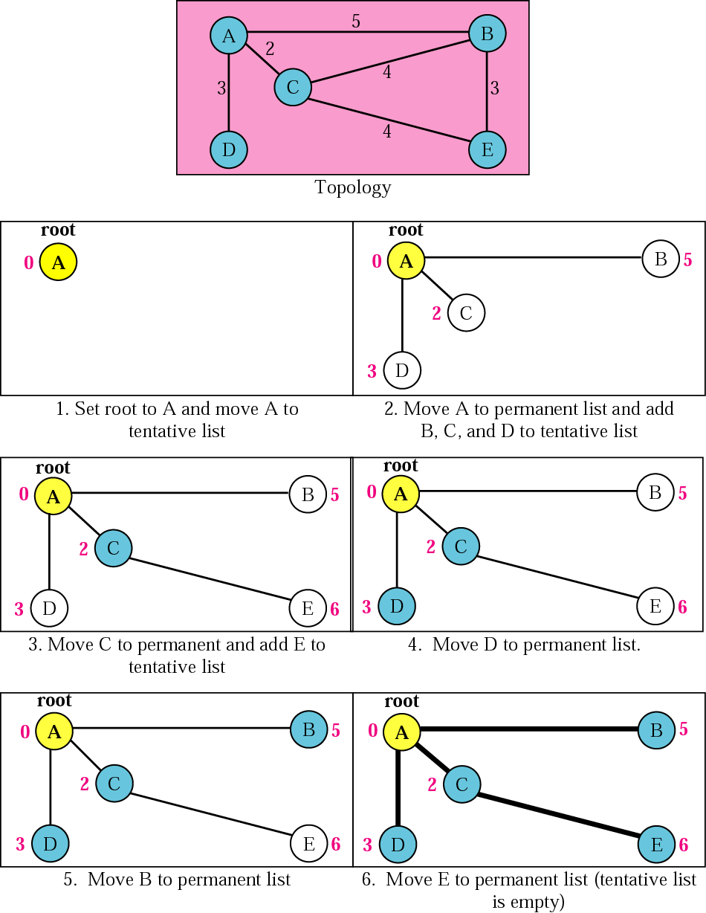
Link State Routing
Concept of Link State

Slide 48
Link State Routing
LSPs are sent out under the following conditions:
Initial router start up or routing process.
When there is a change in topology.
HELLO PACKETS
Every OSPF router sends out 'hello' packets.
Hello packets are used to determine if neighbor is up.
Hello packets are sent periodically.
Once routers learn it has neighbors they form an adjacency and two adjacent neighbors will exchange hello packets.

Slide 49
Open Shortest Path First (OSPF)
The Open Shortest Path First (OSPF) protocol is an intra-domain routing protocol based on link state routing.
Provides authentication of routing messages.
Supports sub-netting.
Supports multicasting.
Link State Database
The collection of all LSAs is called the link-state database.
Each router has an identical link-state database.
If neighboring routers discover each other for the first time, they will exchange their link-state databases.
The link-state databases are exchanged using flooding.

Slide 50
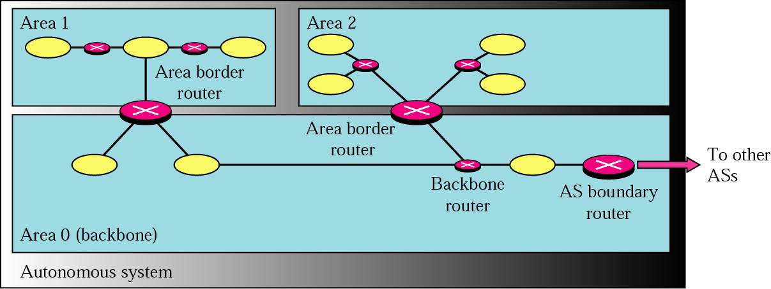
Open Shortest Path First (OSPF)
Discovery of Neighbors
Routers multicasts OSPF Hello packets on all OSPF-enabled interfaces.
If two routers share a link, they can become neighbors, and establish an adjacency.
After becoming a neighbor, routers exchange their link state databases.

Slide 51
Open Shortest Path First (OSPF)
AREA
Area is a collection of networks, hosts, and routers all contained within an autonomous system.
Routers inside an area flood the area with routing information.
Area border routers: Summarize the information about the area and send it to other routers.
Backbone area [Primary area]: All the areas inside an autonomous system must be connected to the backbone.
Routers in this area are called as backbone routers. This area identification number is 0.

Slide 52
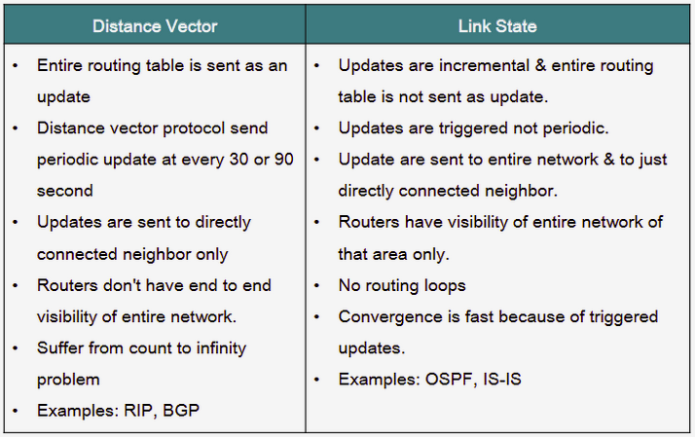
Distance Vector vs Link State
Notes:
IS-IS-→ Intermediate Systems to Intermediate Systems.

Slide 53
Interdomain Routing Protocol
Path Vector Routing (BGP)

Slide 54
Path vector Routing
Border Gateway Protocol is path routing protocol.
BGP also called Exterior Gateway Protocol.
Why BGP?
DV and LS are both Intra-domain routing protocols.
Distance vector routing-hop limit.
Link-state Routing
Huge amount of resources to calculate routing tables.
Heavy traffic-flooding

Slide 55
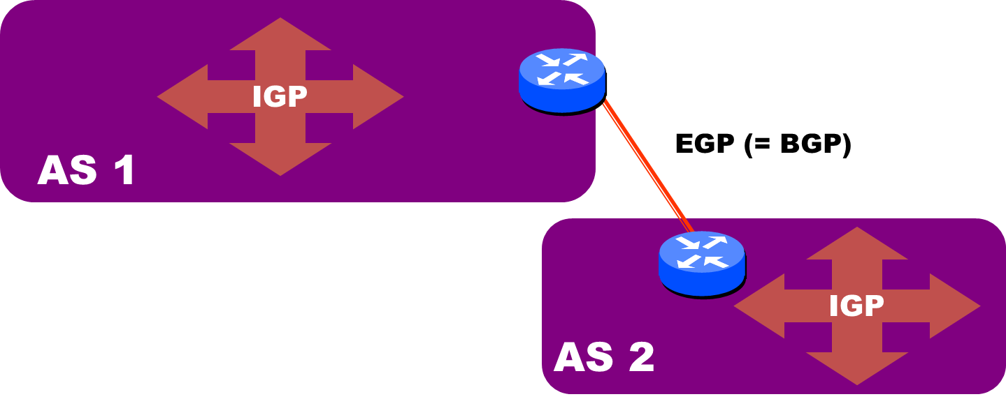
Path vector Routing
There is at least one node, called the speaker node, in each AS that creates a routing table and advertises it to speaker nodes in the neighboring ASs.
Only speaker nodes in each AS can communicate with each other.
Speaker node advertises the path, not the metric.

Slide 56
Path vector Routing
Sharing:
A speaker in an autonomous system shares its table with immediate neighbors.
Updating:
When a speaker node receives a table from its neighbor, it updates its own table by adding the nodes that are not in its routing table.
It also adds its own AS and the AS that sent the table.

Slide 57
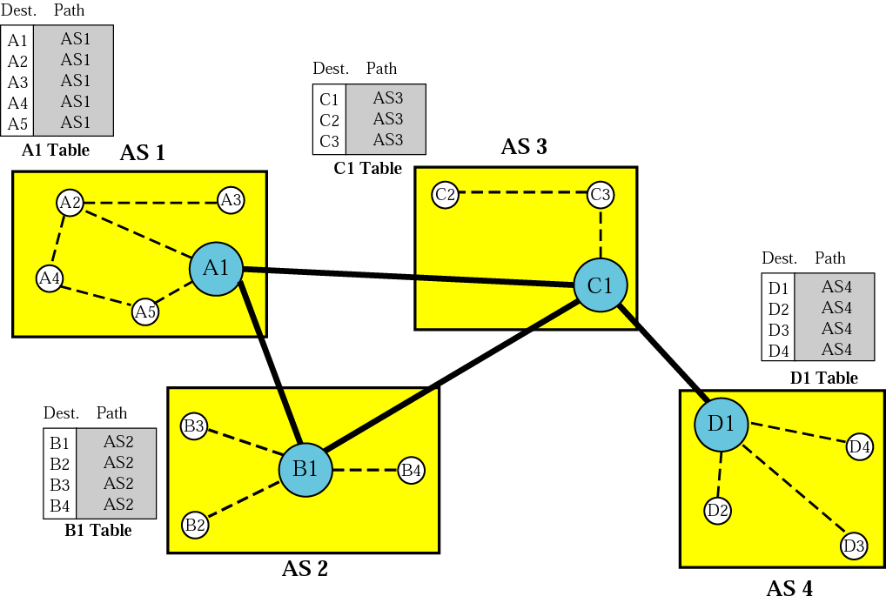
Path vector Routing

Slide 58
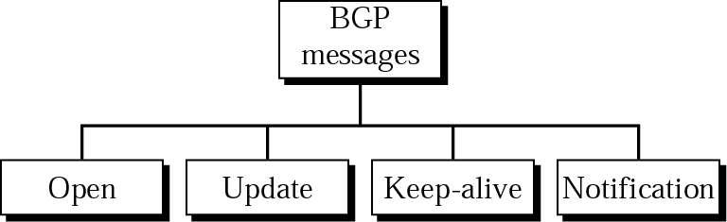
Path vector Routing
Open → To create a neighborhood relationship. If the neighbor accepts the neighborhood relationship, it responds with a keep-alive message, which means that a relationship has been established between two routers.
Update message → It is used by router to withdraw destinations that have been advertised previously, announce a router to a new destination, or do both.
Keep-alive → Routers exchange this message regularly (before their hold time expires) to tell each other that they are alive.
Notification → Sent by a router whenever an error condition is detected or a router wants to close the connection.

Slide 59
EIGRP

Slide 60
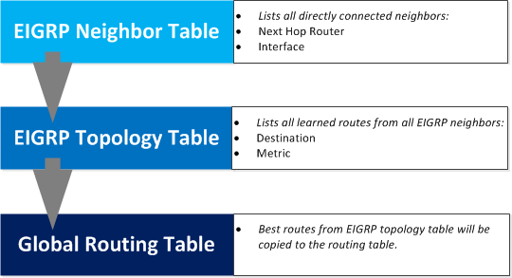
EIGRP
EIGRP stands for Enhanced Interior Gateway Routing Protocol.
EIGRP is Cisco’s proprietary routing protocol.
routers will start sending hello packets to other routers just like OSPF does, if you send hello packets and you receive them you will become neighbors.
EIGRP neighbors will exchange routing information which will be saved in the topology table.

Slide 61
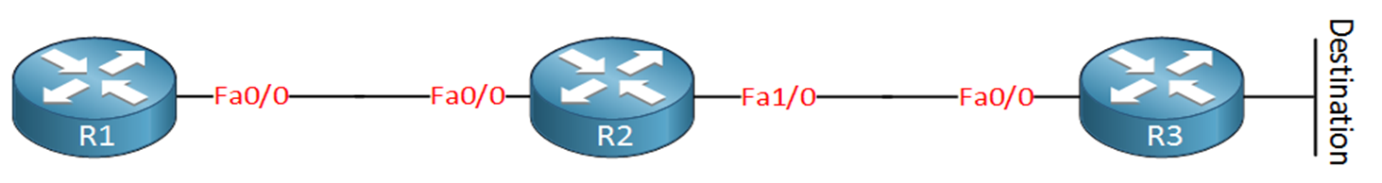
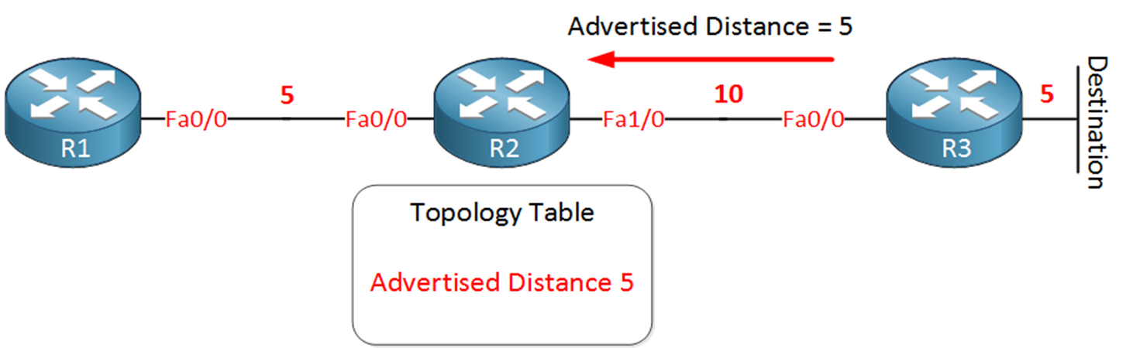
EIGRP
We have three routers named R1, R2, and R3. We are going to calculate the best path to the destination, which is behind R3.
In the picture above I have assigned some values on the interfaces. R3 will advertise to R2 its metric towards the destination.

Slide 62
EIGRP
Basically, R3 is saying to R2: “It costs me 5 to get there”. This is called the advertised distance.
R2 has a topology table, and in this topology table it will save this metric, the advertised distance to reach this destination is 5.

Slide 63
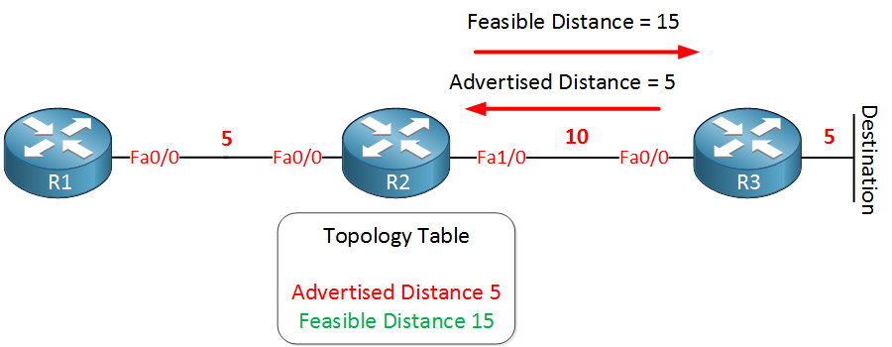
EIGRP
We know the advertised distance is five since this is what R3 told us. But the distance between R2 and R3 is 10. R2 now knows feasible distance is 15, and it will be saved in the topology table.
You have now learned two important concepts of EIGRP. The advertised distance, your neighbor tells you how far it is for him to reach the destination, and the feasible distance which is your total distance to get to the destination.

Slide 64
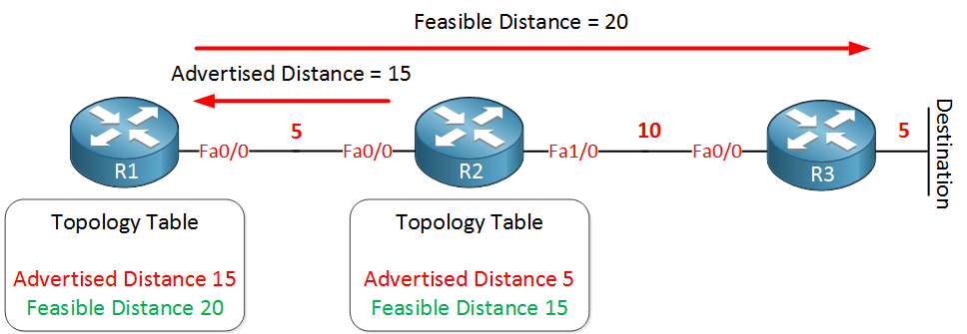
EIGRP
Let’s continue! R2 is sending its feasible distance towards R1, which is 15. R1 will save this information in the topology table as the advertised distance. R2 is “telling” R1 the distance is 15.
We know the advertised distance is 15 since this is what R2 told us. But the distance between R1 and R2 is 5. R1 now knows feasible distance is 20, and it will be saved in the topology table.

Slide 65

Thank
You

